Slide 1
Project Alpha
Group Members: Jason Thomas, Zach Soomro, AJ Peters, Algis Grybauskas, Averil Winston

Slide 2
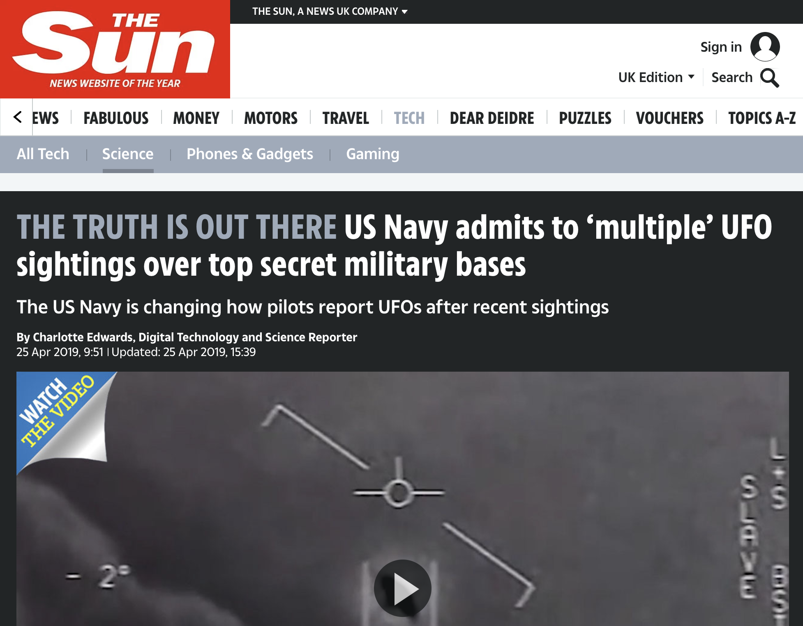

Slide 3
Datasets & API
UFO Sightings Data
Source: The National UFO Reporting Center
Military Base Data
Source: National Transportation Atlas Database (NTAD)
Census Data
Source: US Census Bureau
Google Maps API
Notes:
UFO Sightings Data has over 80,000 reported UFO sightings
Unclear how the National UFO Reporting Center vets their reported sightings
Sightings date back to 1910
Extracted US data only; less than 10% of reported sightings were from outside the United States

Slide 4
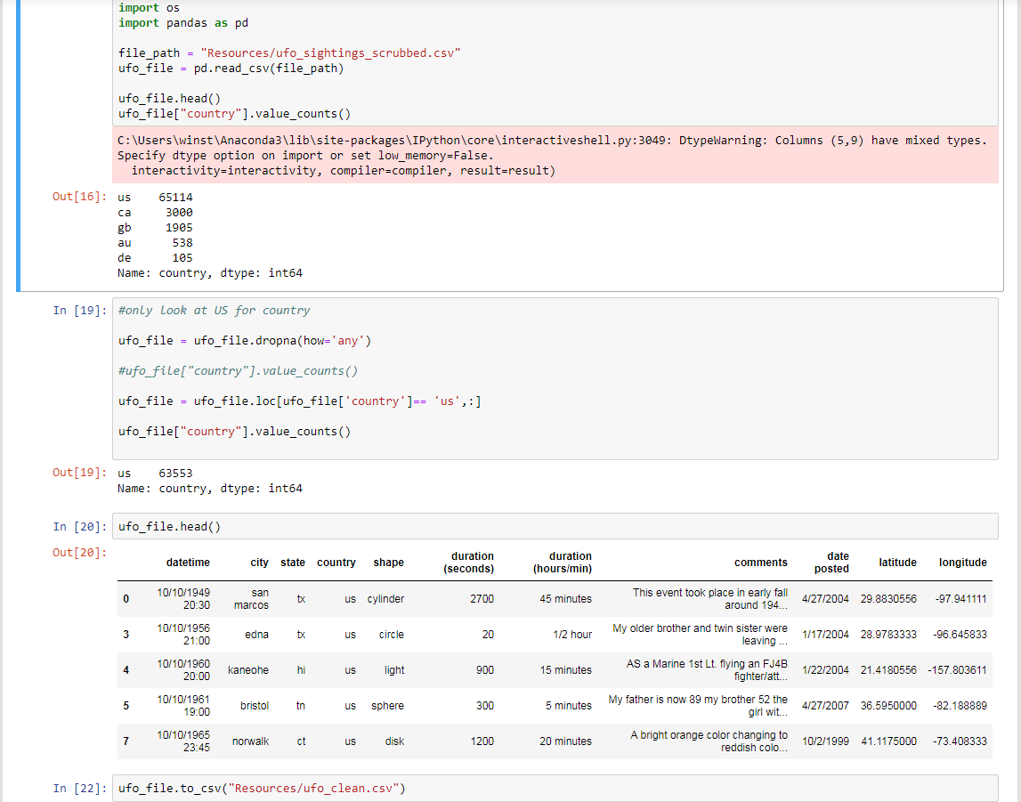
UFO Dataset Cleaning

Slide 5
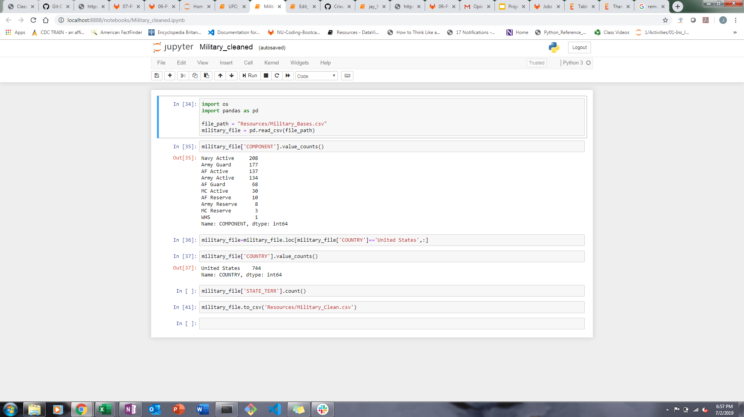
Military Base Dataset Cleaning

Slide 6
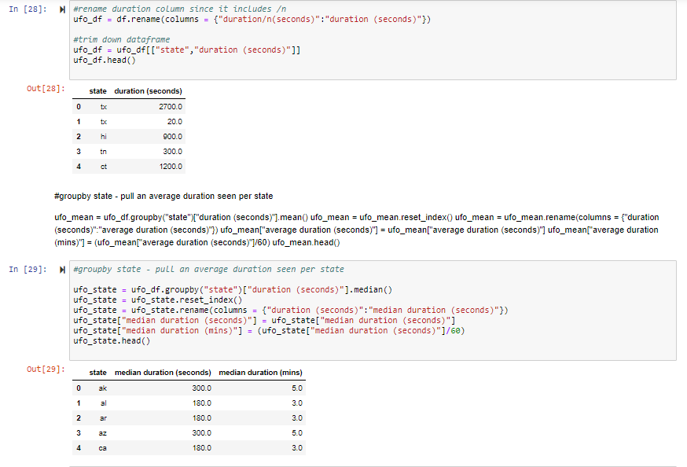
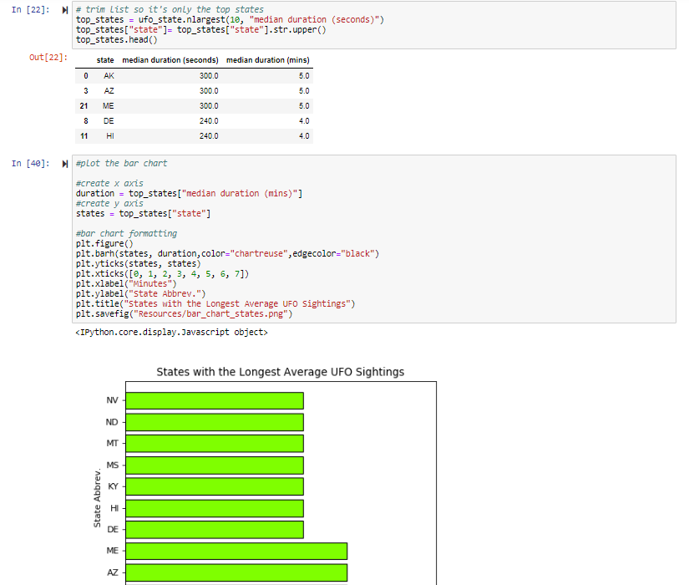
Duration of Sightings x Location
Notes:
Averil
top_states = ufo_state.nlargest(10, "median duration (seconds)")
Duration of Sightings versus State (location)
Groupby State and return an average (median) duration of sightings per state

Slide 7
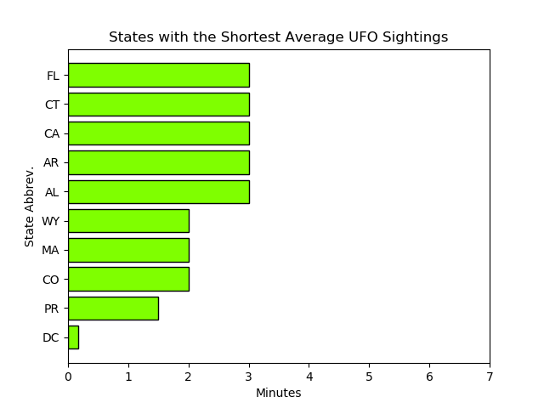
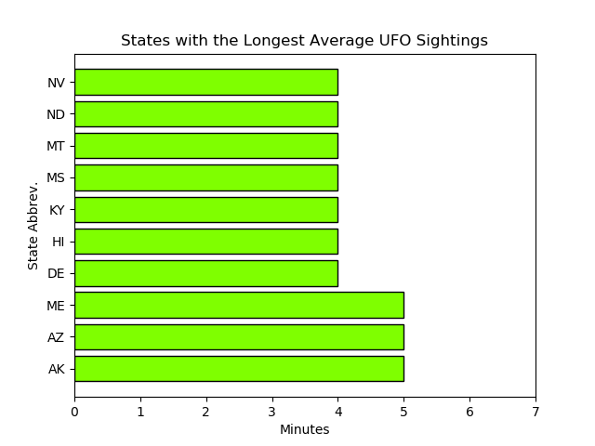
Duration of Sightings x Location
Notes:
Averil
Identify any noticeable trends in the duration of sightings and the location of the reported sighting.
The states with the longest average duration of UFO sightings are Alaska, Arizona and Maine
It was difficult to display all 50 states on one chart so instead, I plotted the states with an above-median average duration of sighting
Overall, the data showed that there were no anomalies; the average duration of sightings in the US was 3 minutes
Average duration of sighting for the entire data set was 1 hr 32 mins

Slide 8
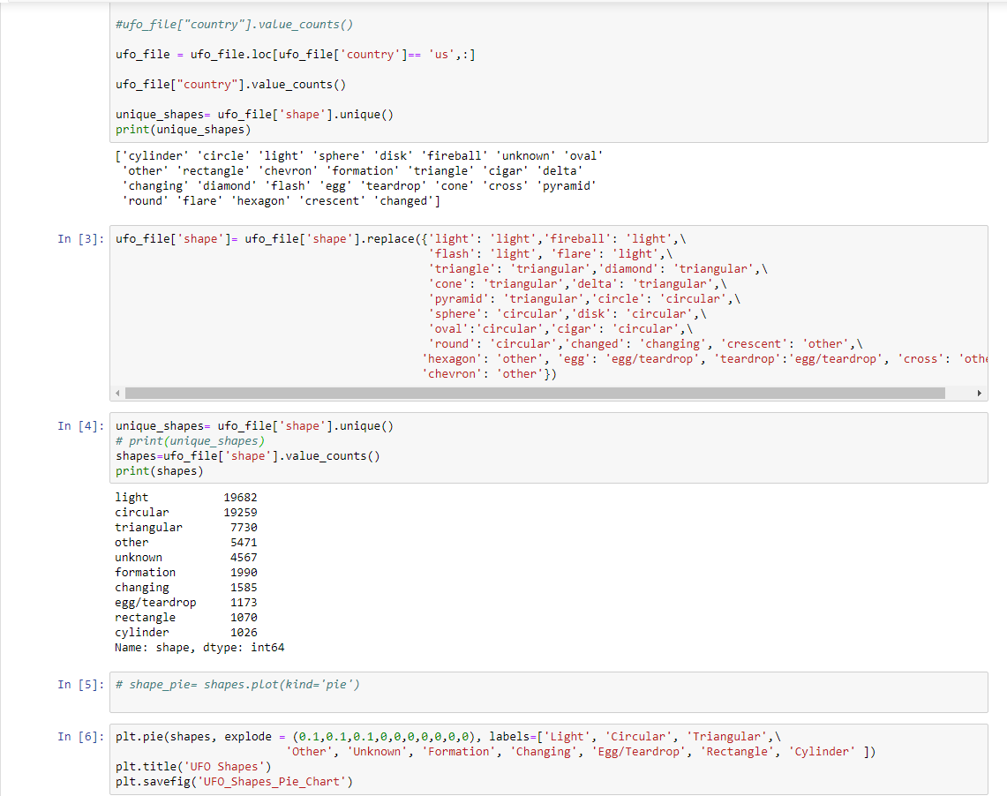
UFO Shape Pie Chart Code

Slide 9
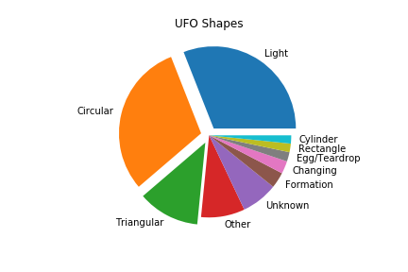
UFO Shape Breakdown

Slide 10
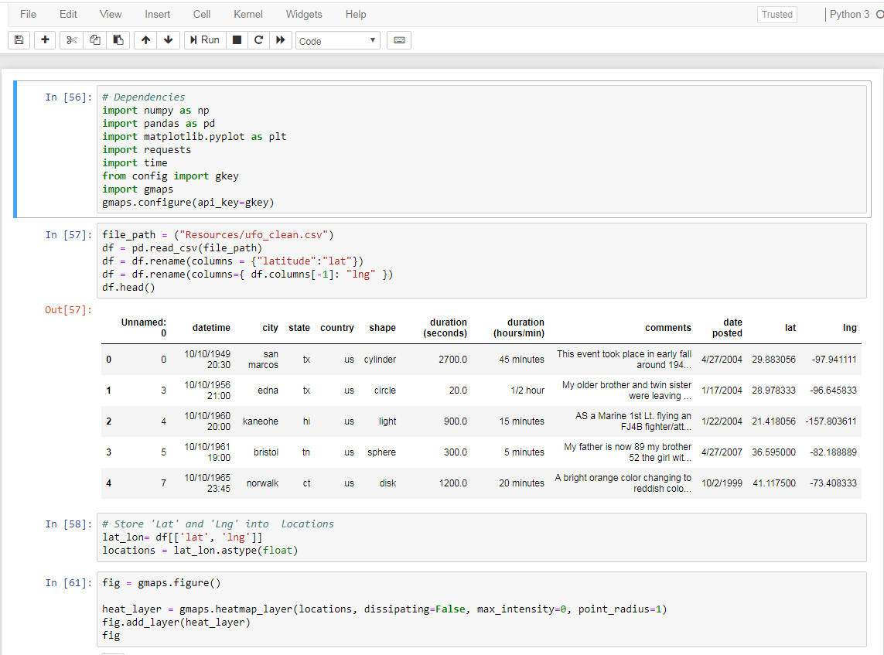
UFO Sighting Heatmap Code

Slide 11
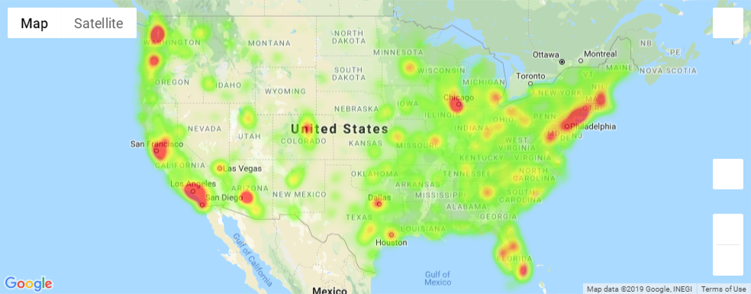
Heatmap - Visualization

Slide 12
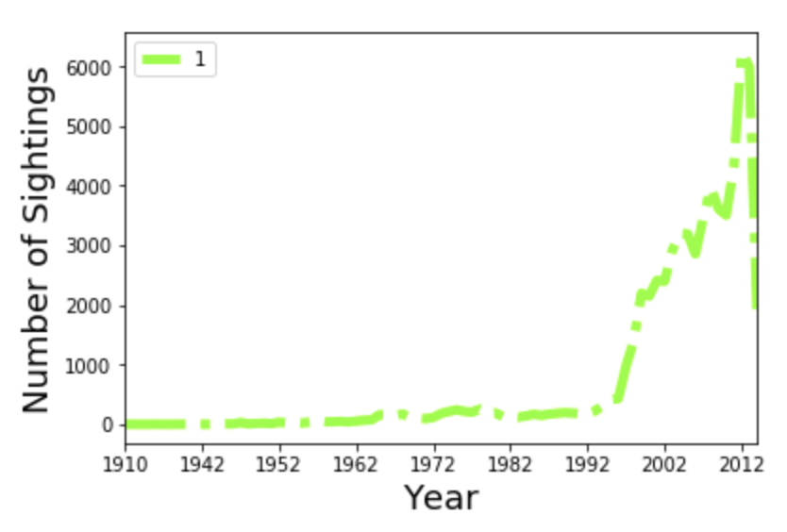
Number of UFO Sightings

Slide 13
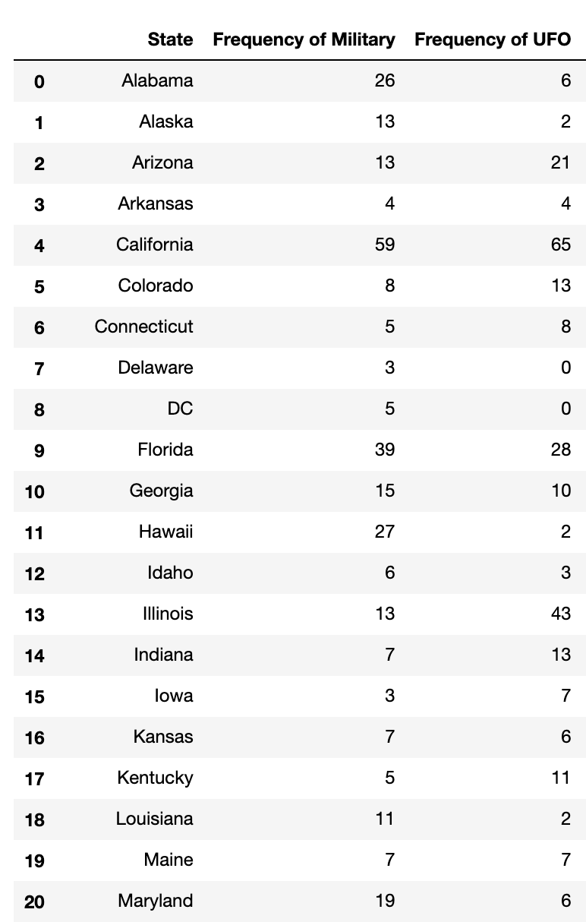
Military Bases
Many ‘Truthers’ claim that the military is hiding UFO information from the public and that the high frequency of UFO sightings near military bases is proof of this
We used military base location data to see if there was a relationship between the number of military bases in an area and the number of UFO sightings in that area
Null Hypothesis: There is no correlation between the number of military bases in an area and the number of UFO sightings in that same area.

Slide 14
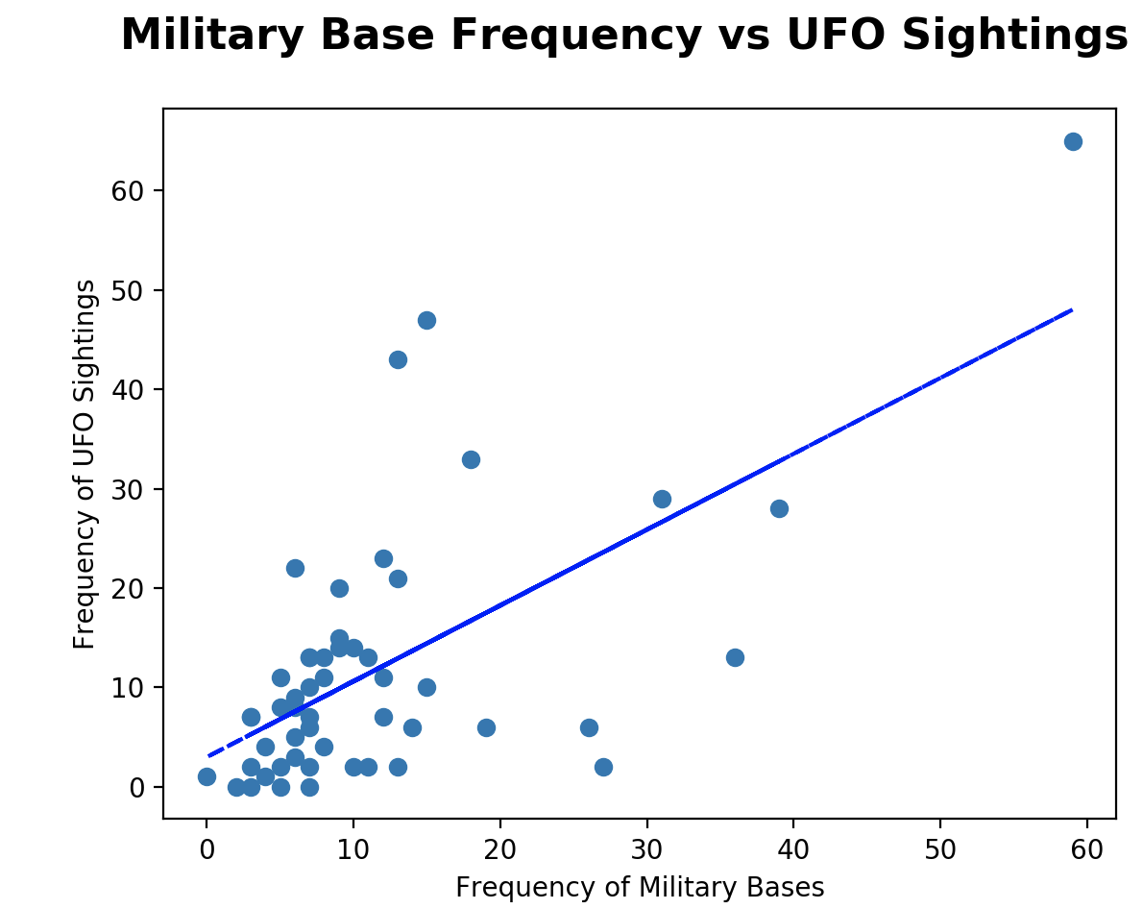
Line of best fit shows a positive correlation (positive slope) between the frequency of military bases and UFO sightings in a particular state
This trend is most likely due to increased populations in states with more military bases. More people= more planes, helicopters, light
Notes:
More bases= more ufo sightings
Most likely due to more people = more flights, helicopters, lights

Slide 15
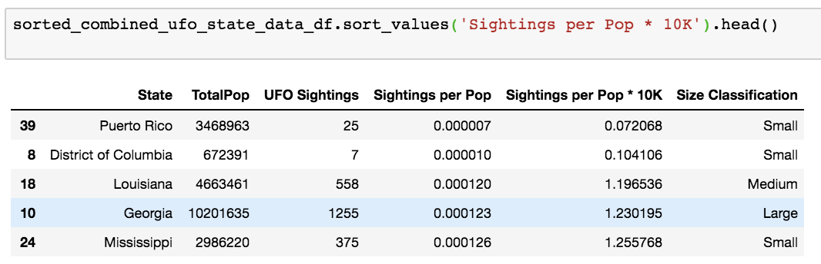
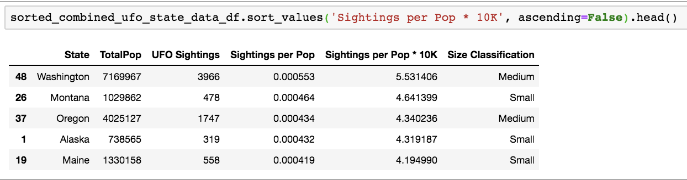
State Population AND UFO SIGHTING Analysis

Slide 16
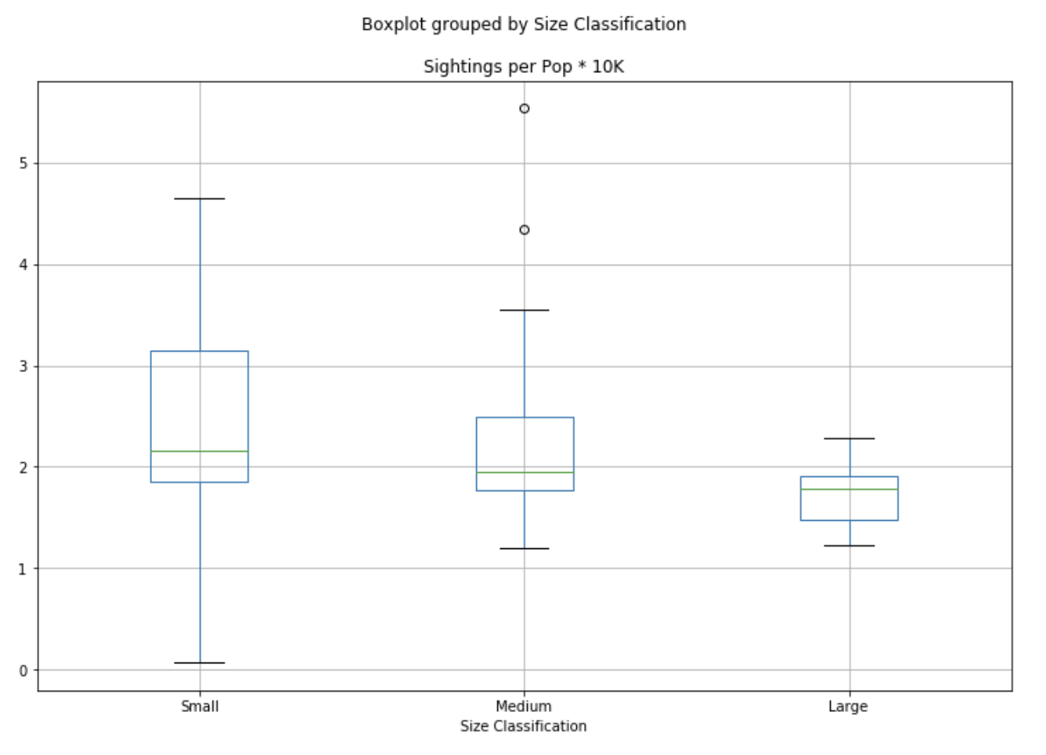
State Population AND UFO SIGHTING Analysis

